Slide 1


DATABASE MANAGEMENT SYSTEM(DBMS)
^{3rd} Sem AIML Prepared by Sanket Nayak, Assistant Professor (CSE - Allied)

Slide 2
UNIT - III
Normalization
Introduction – Purpose of normalization
Functional Dependencies
Lossless Join Decomposition
Dependency Preservation
Normal Forms: First Normal Form (1NF), Second Normal Form (2NF), Third Normal Form (3NF)
Boyce–Codd Normal Form (BCNF)
Multivalued Dependencies (MVDs)
Fourth Normal Form (4NF)
Join Dependencies
Fifth Normal Form (5NF)

Slide 3
Introduction – Purpose of normalization
Normalization in DBMS is a systematic process of arranging data in a relational database to minimize redundancy and improve data integrity. It involves decomposing large tables into smaller, related tables and defining relationships among them using keys.
The primary goal of normalization in DBMS is to ensure that each piece of data is stored only once, thereby avoiding inconsistencies and duplication.
By following normalization rules, we can:
Eliminate redundant data
Ensure logical data storage
Enhance data integrity
To use the memory efficiently.
To eliminate NULL values.

Slide 4
Introduction – Purpose of normalization
Need of Normalization in DBMS?
Eliminating redundant(useless) data, therefore handling data integrity, because if data is repeated it increases the chances of inconsistent data.
Normalization helps in keeping data consistent by storing the data in one table and referencing it everywhere else.
Storage optimization although that is not an issue these days because Database storage is cheap.
Breaking down large tables into smaller tables with relationships, so it makes the database structure more scalable and adaptable.
Ensuring data dependencies make sense i.e. data is logically stored.

Slide 5
Functional Dependencies
A functional dependency occurs when the value of one attribute (or a set of attributes) uniquely determines the value of another attribute. This relationship is denoted as: X → Y
Here, X is the determinant, and Y is the dependent attribute. This means that for each unique value of X, there is precisely one corresponding value of Y.
There are usually a variety of constraints (rules) on the data in the real world.
For example, some of the constraints that are expected to hold in a university database are:
  Students and instructors are uniquely identified by their ID.
  Each student and instructor has only one name.
  Each instructor and student is (primarily) associated with only one department.
  Each department has only one value for its budget, and only one associated building.

Slide 6
Functional Dependencies
Example 1: Consider a table named Students with the following attributes:
StudentID
StudentName
StudentAge
If each student has a unique StudentID, and this ID determines the student's name, we can express this functional dependency as: StudentID → StudentName
Example 2: Given relational schema: Emp_Dept(empid, dno, hours, ename, dname, dept_loc)
Here the possible Functional Dependencies (FDs) are: (a) {empid} → {ename}
Each employee ID uniquely determines the employee name.

Slide 7
Functional Dependencies
(b) {dno} → {dname, dept_loc}
Each department number uniquely determines the department name and its location.
(c) {empid, dno} → {hours}
A combination of employee ID and department number uniquely determines the number of hours the employee works in that department.

Slide 8
Functional Dependencies
A functional dependency occurs when one attribute uniquely determines another attribute within a relation. There are the following types of functional dependencies.
Types of Functional Dependencies –
There are 7 types: i. Full Functional Dependency
ii. Partial Functional Dependency
iii. Transitive Dependency
iv. Trivial Functional Dependency
v. Non-trivial Functional Dependency
vi. Semi Non Trivial Functional Dependencies
vii. Multivalued Functional Dependency

Slide 9
Functional Dependencies
Here are some invalid functional dependencies:
name → dept_name
Students with the same name can have different dept_name, hence this is not a valid functional dependency.
dept_building → dept_name
There can be multiple departments in the same building. Example, in our university departments ECE and EEE are in the same building, hence dept_building → dept_name is an invalid functional dependency.

Slide 10
Functional Dependencies
Armstrong’s axioms/properties of functional dependencies:
Reflexivity: If Y is a subset of X, then X→Y holds by reflexivity rule.
Example, {roll_no, name} → name is valid. 2.
Augmentation: If X → Y is a valid dependency, then XZ → YZ is also valid by the augmentation rule.
Example, {roll_no, name} → dept_building is valid, hence {roll_no, name, dept_name} → {dept_building, dept_name} is also valid.
Transitivity: If X → Y and Y → Z are both valid dependencies, then X → Z is also valid by the Transitivity rule.
Example, roll_no → dept_name & dept_name → dept_building, then roll_no → dept_building is also valid.

Slide 11
Functional Dependencies
Full Functional Dependency:-
In full functional dependency an attribute or a set of attributes uniquely determines another attribute or set of attributes. If a relation R has attributes X, Y, Z with the dependencies X->Y and X->Z which states that those dependencies are fully functional.
Example 1:
Suppose {EmpID, DeptNo} -> {Dname, loc}
But here to determine Department Name and Location the DeptNo is sufficient. So we can refine it by removing EmpID as: {DeptNo} -> {Dname, loc}
Example 2:
Suppose {StudentID, CourseID} → {Grade}
To determine the Grade, we need both StudentID and CourseID.

Slide 12
Functional Dependencies
Full Functional Dependency:-
StudentID alone cannot determine the grade because a student can take multiple courses. CourseID alone cannot determine the grade because many students can enroll in the same course.
Therefore, Grade depends on the entire composite key {StudentID, CourseID}.
Example 3:
Suppose {EmpID, ProjectID} → {HoursWorked}
An employee can work on multiple projects. A project can have multiple employees.
Therefore, EmpID alone cannot determine HoursWorked. Similarly, ProjectID alone cannot determine HoursWorked. Both EmpID and ProjectID together are required.
Therefore:{EmpID, ProjectID} → {HoursWorked}

Slide 13
Functional Dependencies
Partial Functional Dependency:
In partial functional dependency a non key attribute depends on a part of the composite key, rather than the whole key.
A non-key attribute is partially dependent if it depends on only a part of the composite primary key.
If a relation R has attributes X, Y, Z where X and Y are the composite key and Z is non key attribute. Then X->Z is a partial functional dependency in RDBMS.
Example1:
Suppose {EmpID, DeptNo} -> {Dname, loc}
Here we have EmpID and DeptNo as composite primary key. But here {Dname, loc} can be determined using only DeptNo. So they are partially dependent on composite primary key.

Slide 14
Functional Dependencies
Partial Functional Dependency:
Example2:
Suppose: {OrderID, ProductID} → {OrderDate, ProductName, Quantity}
Here OrderID and ProductID form a composite primary key. OrderDate can be determined using only OrderID. ProductName can be determined using only ProductID. Quantity depends on both OrderID and ProductID.
Therefore:
OrderID → OrderDate
ProductID → ProductName
So, OrderDate and ProductName are partially dependent on the composite primary key.

Slide 15
Functional Dependencies
Partial Functional Dependency:
Example3:
Suppose:{RollNo, SubjectCode} → {StudentName, SubjectName, Grade}
Here RollNo and SubjectCode form a composite primary key. StudentName can be determined using only RollNo. SubjectName can be determined using only SubjectCode. Grade requires both RollNo and SubjectCode.
Therefore:
RollNo → StudentName
SubjectCode → SubjectName
Hence, StudentName and SubjectName are partially dependent on the composite primary key.

Slide 16
Functional Dependencies
Transitive Dependency:
If the value of a non-primary attribute can be defined using another non-primary attribute then it is called a transitive dependency.
When any attribute does not require primary key and can easily get value using another non-primary attribute then it is called as Transitive Dependency.
Example-1: Relation: STUDENT(RollNo, StudentName, DeptID, DeptName)
Primary Key: RollNo
Functional Dependencies: RollNo → StudentName, DeptID & DeptID → DeptName
Since: RollNo → DeptID & DeptID → DeptName
Therefore: RollNo → DeptName (indirectly)
This is a transitive dependency because DeptName depends on DeptID, not directly on RollNo.

Slide 17
Functional Dependencies
Transitive Dependency:
Example 2: Suppose: PATIENT(PatientID, PatientName, DoctorID, DoctorName, Specialization)
Primary Key: PatientID
Functional Dependencies: PatientID → PatientName, DoctorID & DoctorID → DoctorName, Specialization
Since: PatientID → DoctorID & DoctorID → DoctorName, Specialization
Therefore: PatientID → DoctorName, Specialization. This is a transitive dependency.

Slide 18
Functional Dependencies
Trivial Functional Dependency:
In Trivial Functional Dependency, a dependent is always a subset of the determinant. i.e., If X → Y and Y is the subset of X, then it is called a trivial functional dependency.
Symbolically: A→B is a trivial functional dependency if B is a subset of A.
The following dependencies are also trivial: A→A & B→B
In simple words: If all the attributes on the right side are already present on the left side, the FD is trivial.
Example-1:
Suppose: {EmpID, EmpName} → EmpName
Here, EmpName is already present on the left side.
Therefore: EmpName ⊆ {EmpID, EmpName}
So, this is a trivial functional dependency.

Slide 19
Functional Dependencies
Trivial Functional Dependency:
Example-2:
Suppose: {RollNo, StudentName} → RollNo
Here, RollNo is already present on the left side.
Therefore, it is a trivial FD.
Example-3:
Suppose: {EmpID, DeptNo} → {EmpID, DeptNo}
Both attributes on the RHS are already present on the LHS.
Therefore, it is a trivial FD.

Slide 20
Functional Dependencies
Non - Trivial Functional Dependency:
A Non-Trivial Functional Dependency (FD) is a functional dependency where at least one attribute on the right-hand side (RHS) is NOT present on the left-hand side (LHS).
In Non-trivial functional dependency, the dependent is strictly not a subset of the determinant. i.e. If X → Y and Y is not a subset of X, then it is called Non-trivial functional dependency.
In simple words: If the RHS contains an attribute that is not already present in the LHS, the FD is non-trivial.
Example-1:
Suppose: EmpID → EmpName
Here: LHS = EmpID & RHS = EmpName
EmpName is not present in LHS.

Slide 21
Functional Dependencies
Non - Trivial Functional Dependency:
Therefore: EmpID → EmpName is a Non-Trivial FD.
It means EmpID determines EmpName.
Example-2:
Suppose: RollNo → StudentName, Department
Here: LHS = {RollNo} & RHS = {StudentName, Department}
Neither StudentName nor Department is present in LHS.
Therefore: RollNo → {StudentName, Department} is a Non-Trivial FD.

Slide 22
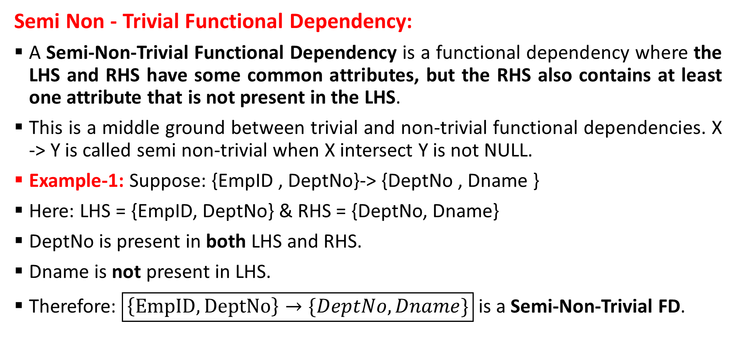
Functional Dependencies
Semi Non - Trivial Functional Dependency:
A Semi-Non-Trivial Functional Dependency is a functional dependency where the LHS and RHS have some common attributes, but the RHS also contains at least one attribute that is not present in the LHS.
This is a middle ground between trivial and non-trivial functional dependencies. X -> Y is called semi non-trivial when X intersect Y is not NULL.
Example-1: Suppose: {EmpID , DeptNo}-> {DeptNo , Dname }
Here: LHS = {EmpID, DeptNo} & RHS = {DeptNo, Dname}
DeptNo is present in both LHS and RHS.
Dname is not present in LHS.
Therefore: $\boxed{\left\{EmpID,DeptNo\right\}→\{DeptNo, Dname\}}$ is a Semi-Non-Trivial FD.

Slide 23
Normalization
Normalization: It is a systematic approach of decomposing tables to eliminate data redundancy and undesirable characteristics like insertion. deletion and modification.
The poor database design gives rise to many anomalies. This anomalies can be avoided by a process called Decomposition process or “Normalization”.
The guidelines for constructing relation scheme having desirable property and avoiding anomalies are called normal forms.
Normalization is a process of designing the scheme in an appropriate normal from that can allow to retrieve information easily.
Advantages of normalization
> Improve database design.
> Ensures minimum redundancy of data.
> Removes anomalies for database activity.
> Eliminate the problems of flow data querying and using memory space usage.

Slide 24
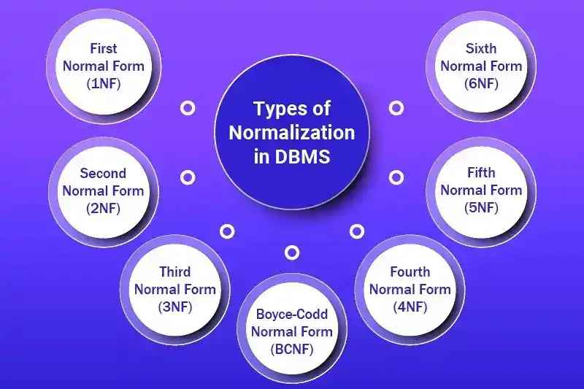
Normalization
Types of Normalization:
First normal form (1NF)
Second normal form (2NF)
Third normal form (3NF)
Boyee codd normal form (BCNF)
Fourth normal form (4NF)
Fifth normal form (5NF)

Slide 25
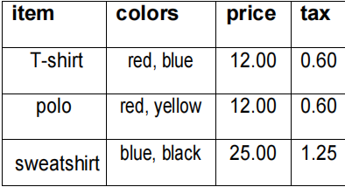
Normalization
First normal form (1NF):
A table will be in first normal form when each cell in the table contains precisely one value that means multivalued attribute is not allowed.
Every attribute contains a single, indivisible value & Each cell in the table should store a single piece of information.
Example: We might have to store data item, colours, price and tax. As every item can have more than one colour so, the arrangement might look like this table.

Slide 26
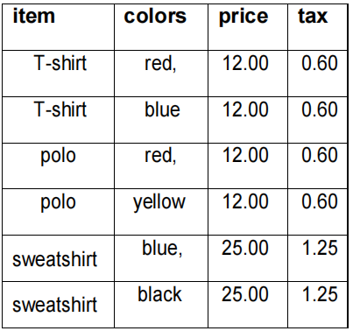
Normalization
First normal form (1NF):
The Table is not in first normal form because Multiple items present in colour field. To make the table in 1NF we should have the data like this.

Slide 27
Normalization
Second normal form (2NF):
A relation schema is in second normal form
If it is in first normal form(1NF).
If non-key attribute is not functionally dependant on part of the key attribute (i.e. no partial dependency) i.e. if the non key attribute is fully functional dependent of key attribute.
In simple words A relation is said to be in 2NF. If it satisfies 1Nf and it has no partial dependency. [primary key should be unique].
Example: The given table is in 1NF because each field contain single attribute. Here we have taken {item, colour} as primary key. However the table is not in 2NF because the non key attribute price and tax depend only on item, but not on colour which is a part of the primary key. This violates the rule for 2NF as the rule says no non-key attribute is functionally dependant on part of the key attribute.

Slide 28
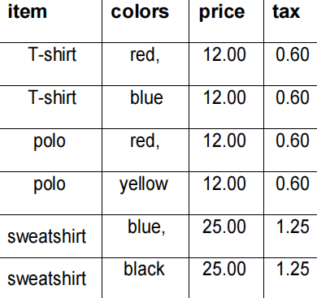
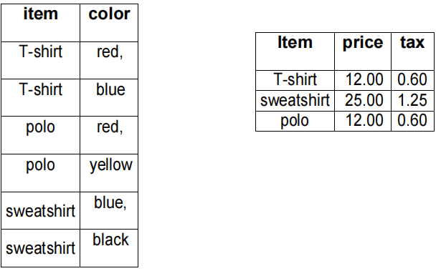
Normalization
Second normal form (2NF):
To make the table complies with 2NF we can break it in two tables like this:

Slide 29
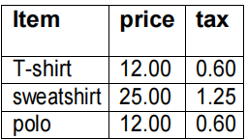
Normalization
Third normal form (3NF):
A relation R is said to be 3NF.
If it is in 2NF.
All non-key attribute are functionally depends on the key attribute(primary key)in other words we can say on non-key attribute of relation R is not transitively depend on the key attribute.
Example:
In this table item is the Primary key. The non key attribute tax depends on price not on item.
Here item -> price and price -> tax. So item -> tax.
That means transitive dependency exists here.
Therefore the table is not in 3NF.

Slide 30
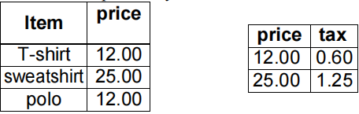
Normalization
Third normal form (3NF):
To make that table complies with 3NF we have to break the table into two tables to remove the transitive dependency.

Slide 31
Normalization
Boyce codd normal form (BCNF):
It is slightly stronger version of 3NF.
A table is in BCNF if and only if, it is in 3NF and for every functional X->Y, X should be the super key of the table..
The BCNF is a special case of 3NF and BCNF can only be violated if a 3NF complaint table contain more than one candidate key.
CHARACTERISTICS:-
3NF (special case)
Every determinant is a candidate key.
Example: Suppose there is a company wherein employees work in more than one department.
They store the data like this:

Slide 32
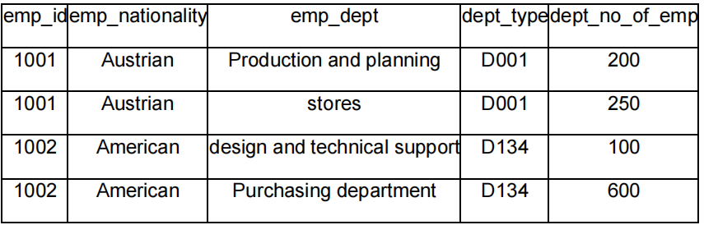
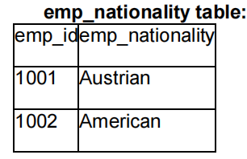
Normalization
Boyce codd normal form (BCNF):
Functional dependencies in the table above:
emp_id -> emp_nationality
emp_dept -> {dept_type, dept_no_of_emp}
Candidate key: {emp_id, emp_dept}
The table is not in BCNF as neither emp_id nor emp_dept alone are keys.
To make the table comply with BCNF we can break the table in three tables like this:

Slide 33
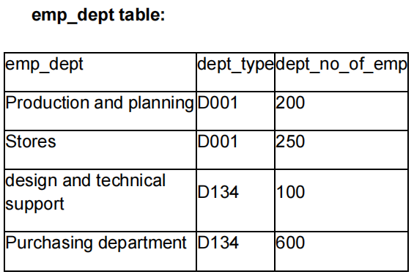
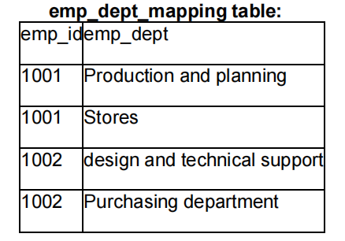
Normalization
Boyce codd normal form (BCNF):
Functional dependencies:
emp_id -> emp_nationality
emp_dept -> {dept_type, dept_no_of_emp}
Candidate keys:
For first table: emp_id
For second table: emp_dept
For third table: {emp_id, emp_dept}
This is now in BCNF as in both the functional dependencies left side part is a key.

Slide 34
Normalization
Fourth normal form (4NF):
A relation is said to be in 4NF if it is in Boyce Codd normal form and should have no multi. Valued dependency.
A table is in 4NF if it is in BCNF and has no multi-valued dependencies. A multi-valued dependency occurs when one attribute determines another, and both attributes are independent of all other attributes in the table.
Examples:- STUDENT(StudentID, Skill, Hobby)
Suppose a student can have multiple skills and multiple hobbies, and the skills are independent of the hobbies.
StudentID | Skill | Hobby
S101 | Java | Cricket
S101 | Java | Music
S101 | Python | Cricket
S101 | Python | Music

Slide 35
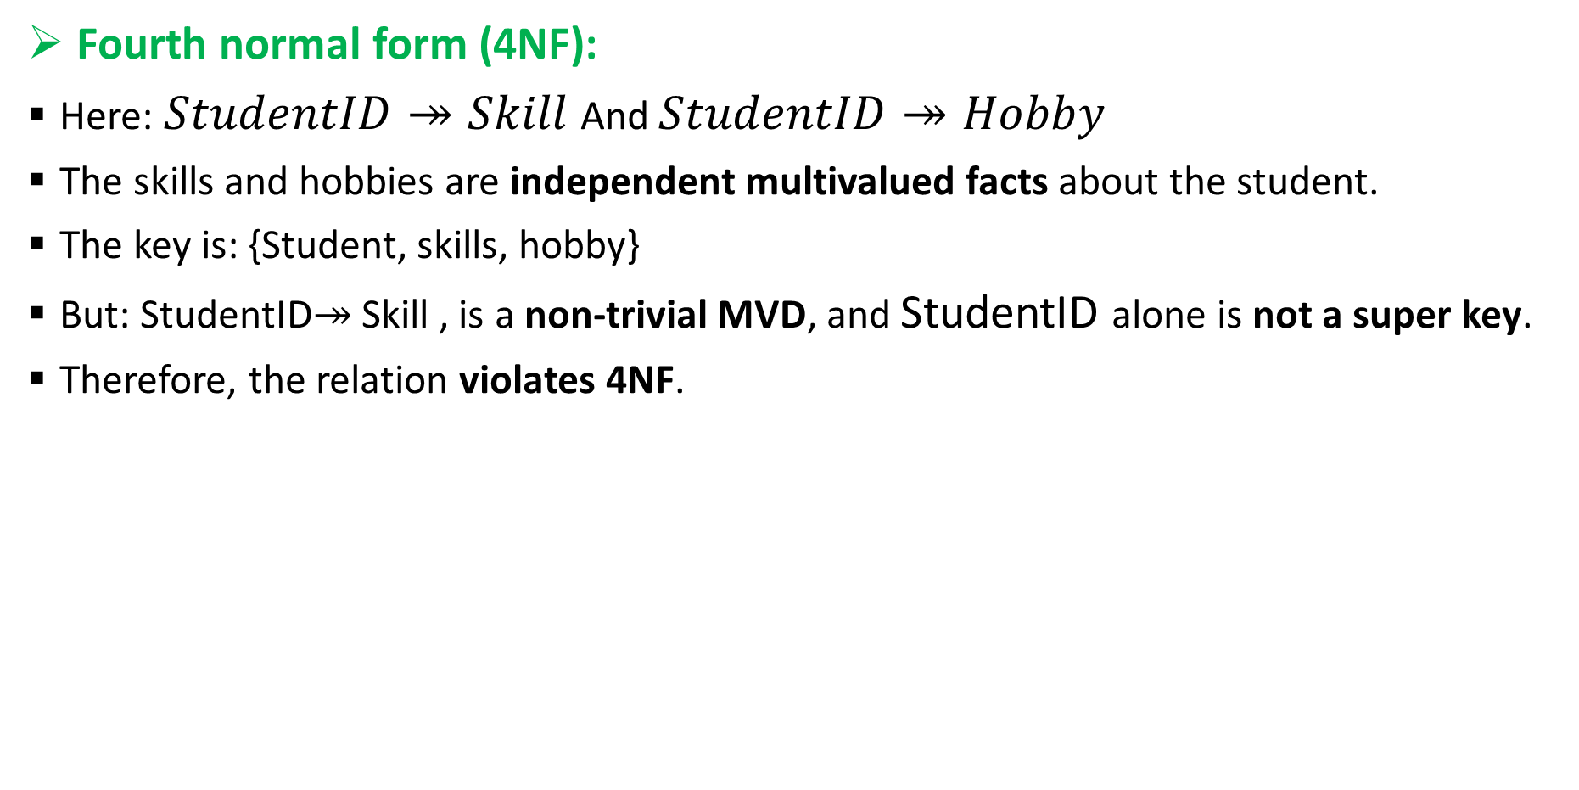
Normalization
Fourth normal form (4NF):
Here: $StudentID↠Skill$And $StudentID↠Hobby$
The skills and hobbies are independent multivalued facts about the student.
The key is: {Student, skills, hobby}
But: StudentID↠ Skill , is a non-trivial MVD, and StudentID alone is not a super key.
Therefore, the relation violates 4NF.
StudentID | Skill
S101 | Java
S101 | Python
StudentID | Hobby
S101 | Cricket
S101 | Music

Slide 36
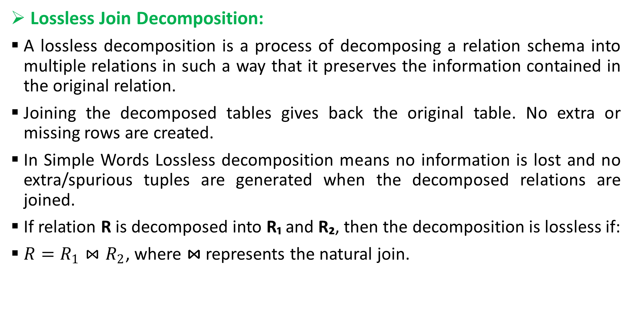
Normalization
Lossless Join Decomposition:
A lossless decomposition is a process of decomposing a relation schema into multiple relations in such a way that it preserves the information contained in the original relation.
Joining the decomposed tables gives back the original table. No extra or missing rows are created.
In Simple Words Lossless decomposition means no information is lost and no extra/spurious tuples are generated when the decomposed relations are joined.
If relation R is decomposed into R₁ and R₂, then the decomposition is lossless if:
$R=R_{1}⋈R_{2}$, where ⋈ represents the natural join.

Slide 37
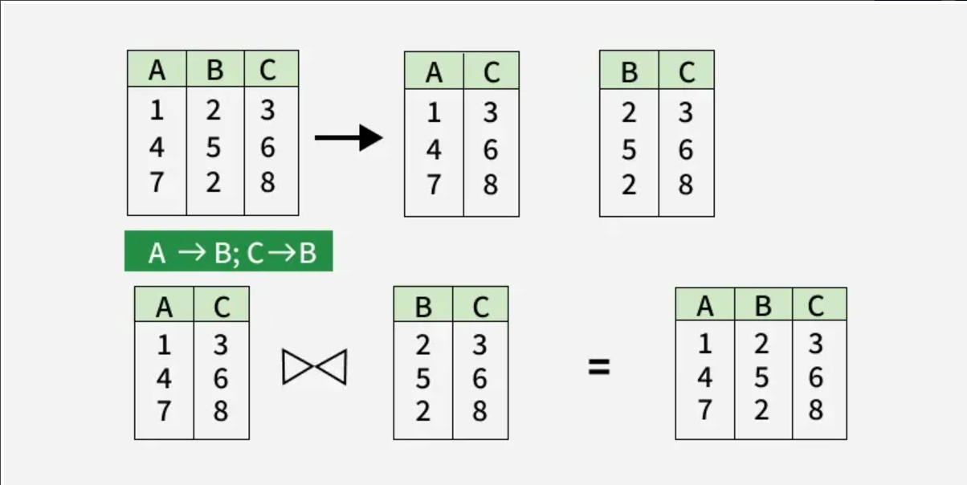
Normalization
Lossless Join Decomposition:
Example:

Slide 38
Normalization
Dependency Preservation:
In a Database Management System (DBMS), dependency-preserving decomposition refers to the process of breaking down a complex database schema into simpler, smaller tables, such that all the functional dependencies of the original schema are still enforceable without needing to perform additional joins.
Dependency Preservation is a desirable property of relational database decomposition.
When a relation is decomposed into multiple smaller relations, the functional dependencies (FDs) of the original relation should still be enforceable by checking the individual decomposed relations without performing a join.

Slide 39
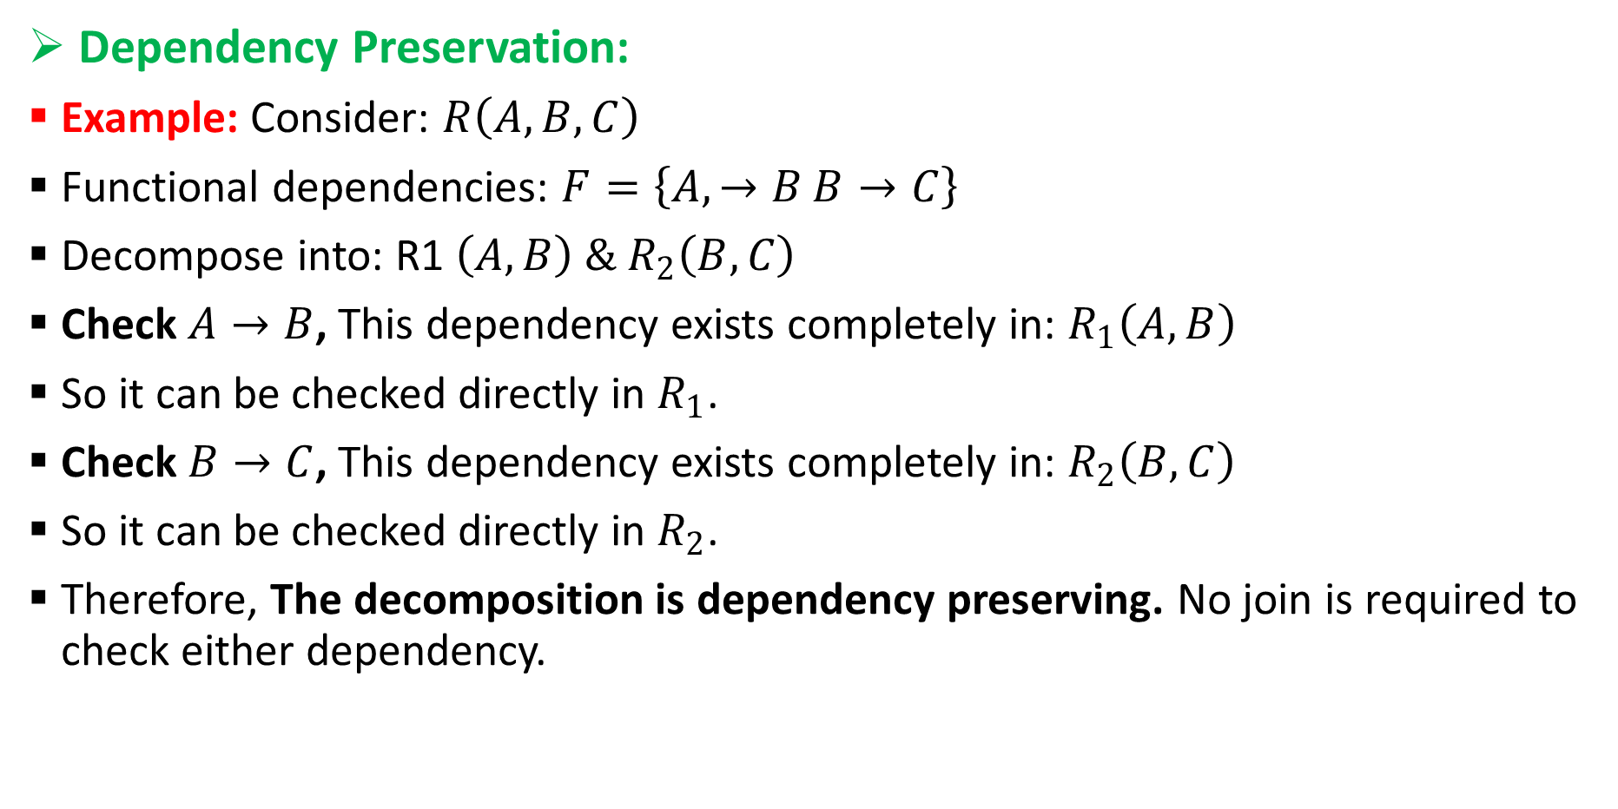
Normalization
Dependency Preservation:
Example: Consider: $R\left(A , B , C\right)$
Functional dependencies: $F=\left\{A , →B B→C\right\}$
Decompose into: R1 $\left(A , B\right) \& R_{2}\left(B , C\right)$
Check $A→B$, This dependency exists completely in: $R_{1}\left(A , B\right)$
So it can be checked directly in $R_{1}$.
Check $B→C$, This dependency exists completely in: $R_{2}\left(B , C\right)$
So it can be checked directly in $R_{2}$.
Therefore, The decomposition is dependency preserving. No join is required to check either dependency.

Slide 40
Normalization
Fifth normal form (5NF):
Key Principle: Lossless Decomposition: A table should be decomposed in such a way that it can be perfectly reconstructed without any loss of data or creation of spurious rows.
To reach 5NF: Table must be in 4NF.
Lossless join decomposition: When a table is divided vertically into multiple tables, the recombined result should exactly match the original data, with no extra rows generated. This is particularly important when dealing with complex interrelationships among data.
Candidate key as a common attribute: When splitting tables, ensuring that the common attribute is a candidate key helps maintain a lossless join, meaning that joining the decomposed tables will not introduce redundancy or errors.

Slide 41
Normalization
Fifth normal form (5NF):

Slide 42
Normalization
Multi valued dependencies(MVD):
Multivalued dependency (MVD) is a type of dependency that exists when a table contains more than one multivalued attribute and changes to one attribute can affect another attribute.
In other words, MVD occurs when a table has a non-trivial relationship between attributes that are not part of the same composite key.
Multivalued dependency occurs when two attributes in a table are independent of each other but, both depend on a third attribute.
A multivalued dependency consists of at least two attributes that are dependent on a third attribute that's why it always requires at least three attributes.
It is represented as: X↠Y​, where X multi-determines Y Or Y is multivalued dependent on X.

Slide 43
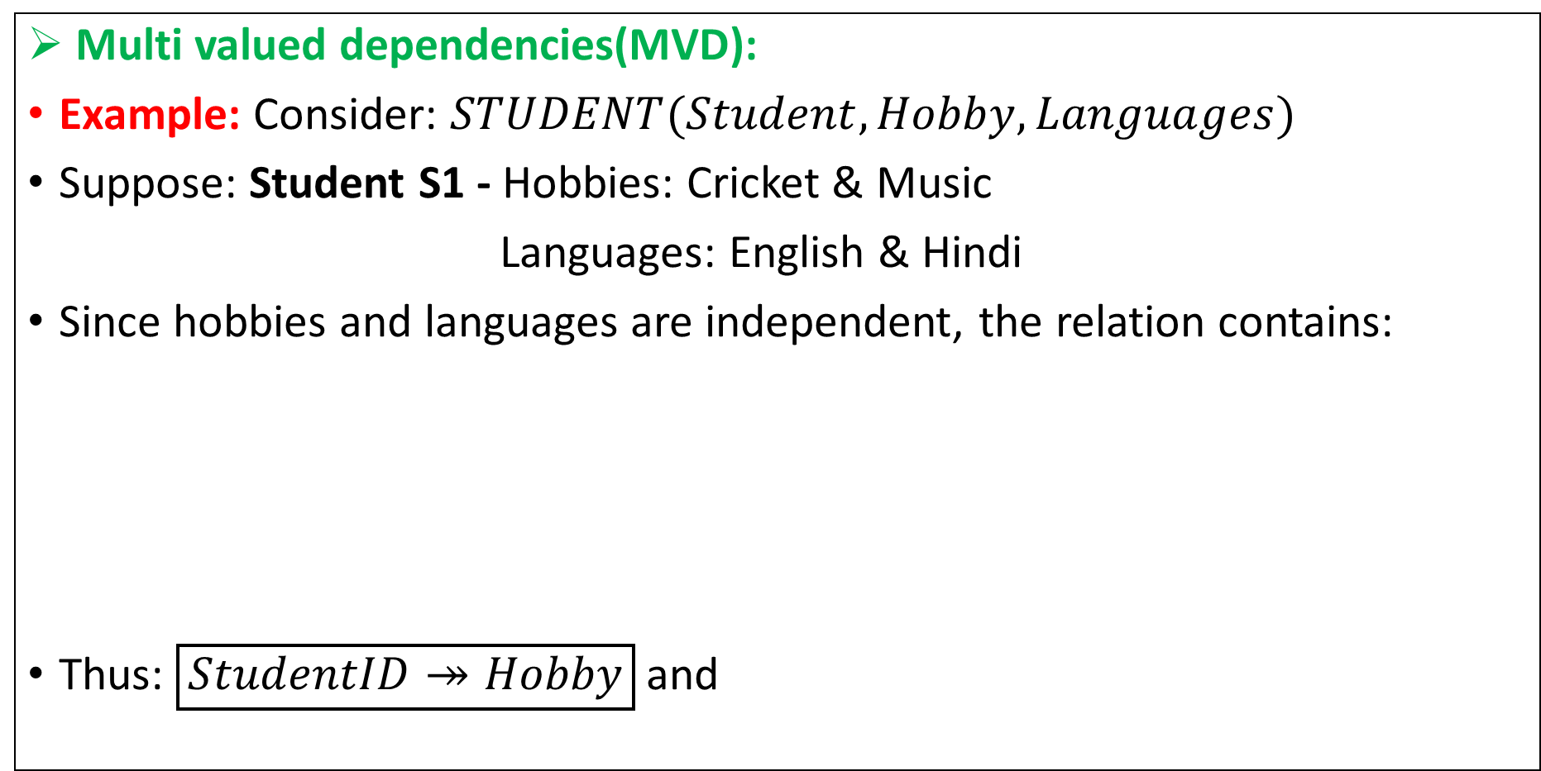
Normalization
Multi valued dependencies(MVD):
Example: Consider: $STUDENT(Student,Hobby,Languages)$
Suppose: Student S1 - Hobbies: Cricket & Music
Languages: English & Hindi
Since hobbies and languages are independent, the relation contains:
Thus: $\boxed{StudentID↠Hobby}$ and ​
StudentID | Hobby | Language
S1 | Cricket | English
S1 | Cricket | Hindi
S1 | Music | English
S1 | Music | Hindi
StudentID ↠ Language

Slide 44
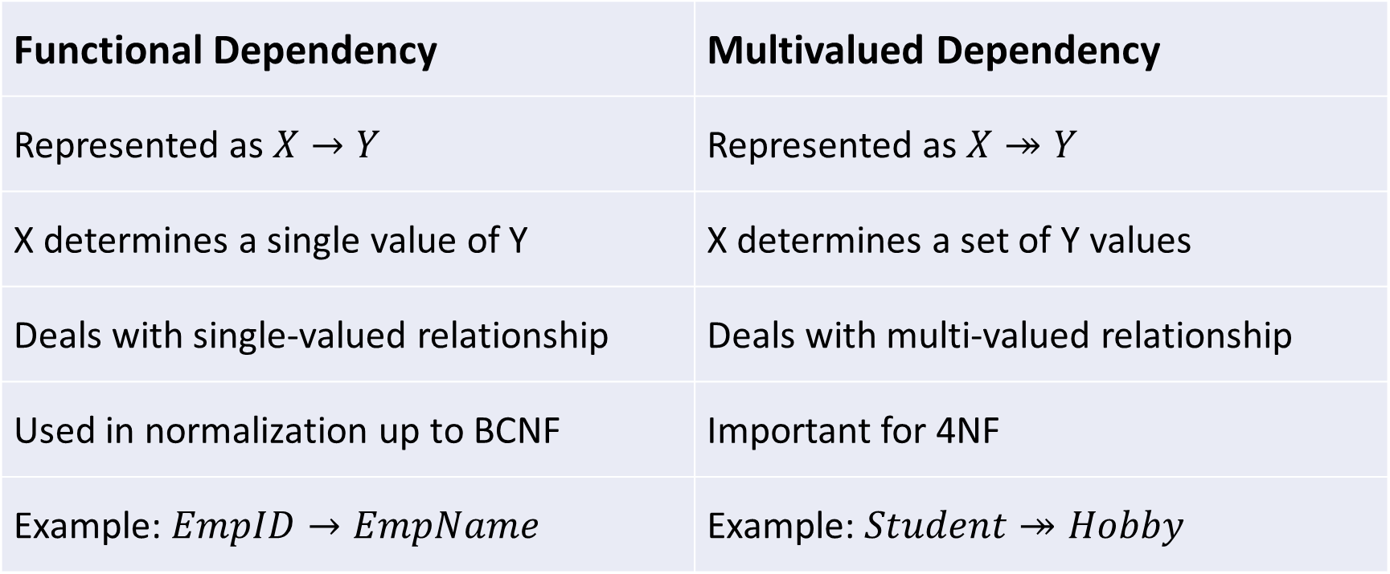
Normalization
Multi valued dependencies(MVD):
MVD vs Functional Dependency
Functional Dependency | Multivalued Dependency
Represented as $X→Y$ | Represented as $X↠Y$
X determines a single value of Y | X determines a set of Y values
Deals with single-valued relationship | Deals with multi-valued relationship
Used in normalization up to BCNF | Important for 4NF
Example: $EmpID→EmpName$ | Example: $Student↠Hobby$

Slide 45
Thank You !!!

